Slide 1
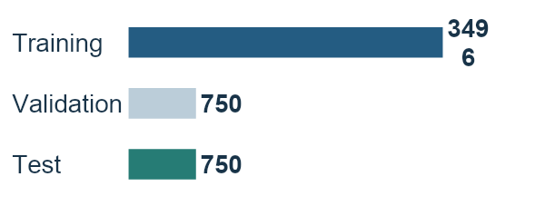
Data preparation
5,000 TGLF simulations
70/15/15 split
3,496
11 plasma inputs
Log heat flux targets
Signed particle flux
Notes:
Source: /Users/ryanlindberg/Desktop/Classes/DSC180A/assignments/A2/01_prepare_data.ipynb and /Users/ryanlindberg/Desktop/Classes/DSC180A/assignments/A2/prepared/preparation_metadata.json. The source dataset contains 5,000 cases. Four cases with negative ion heat flux are held for physics or solver review because heat targets use log10. This does not establish that those simulations are wrong. The eligible split is 3,496 training, 750 validation, and 750 test. Eleven retained physical inputs predict ion heat Q_i, electron heat Q_e, and signed electron particle flux Gamma_e. Inputs and targets are standardized using training statistics only. Heat targets use log10 and particle flux retains its sign.

Slide 2
Five-network ensemble
11
64
64
8
3
a/L_{Te}
a/L_{Ti}
a/L_{n}
Qᵢ
T_{i}/T_{e}
q
κ
⋮
⋮
Qₑ
R′
r/a
m_{i}/m_{D}
Γₑ
log₁₀ ν̂_{ei}
ŝ
Inputs
GELU
GELU
ReLU
Outputs
Notes:
Source: /Users/ryanlindberg/Desktop/Classes/DSC180A/assignments/A2/nn_ensemble.py and /Users/ryanlindberg/Desktop/Classes/DSC180A/assignments/A2/02_nn_ensemble.ipynb. All five saved networks use 11, 64, 64, 8, and 3 units. The 64-unit layers are abbreviated visually. Hidden activations are GELU, GELU, and ReLU; the output head is linear. Each model has 5,475 parameters. Seeds 42 through 46 vary initialization and minibatch order, using the same data. AdamW uses batch size 256 and weight decay 0.0001. The saved models minimize normalized validation RMSE, with early stopping. Before averaging, undo target standardization, then exponentiate the two heat outputs with 10**x. Average each member's predictions equally in original gyro-Bohm flux units. The final three outputs are ion heat, electron heat, and signed electron particle flux. The ensemble spread is not a calibrated uncertainty estimate. Activation comparison: GELU/ReLU gives mean validation NRMSE 0.180636, versus 0.188674 for GELU/tanh, a 4.26% reduction. We promoted its exact five checkpoints. Four combinations used matching initial weights, seeds, splits, and fixed training settings. The continuation learning rate 0.003 came from the earlier GELU/tanh experiment and was not retuned separately. Source: /Users/ryanlindberg/Desktop/Classes/DSC180A/assignments/A2/04_activation_comparison.ipynb and /Users/ryanlindberg/Desktop/Classes/DSC180A/assignments/A2/experiments/activation_results/ensemble_metrics.csv.
Input symbols, top to bottom, follow the exact feature order in prepared/preparation_metadata.json and prepared/features.csv. RLTS_1 = a/L_Te, RLTS_2 = a/L_Ti, RLNS_1 = a/L_n (the electron and ion density gradients are equal), TAUS_2 = T_i/T_e, Q_LOC = q (positive safety factor), KAPPA_LOC = κ, DRMAJDX_LOC = R′ = ∂R_maj/∂x, RMIN_LOC = r/a, MASS_2 = m_i/m_D, log10_XNUE = log10(ν̂_ei), and magnetic_shear = ŝ. Here ν̂_ei = ν_ei a/c_s is the normalized collision frequency XNUE, and ŝ = Q_PRIME_LOC × RMIN_LOC² / Q_LOC². Each input is standardized with training-set statistics before the first layer. Source for TGLF parameter definitions: https://gafusion.github.io/doc/tglf/tglf_table.html (accessed 2026-10-24).

Slide 3
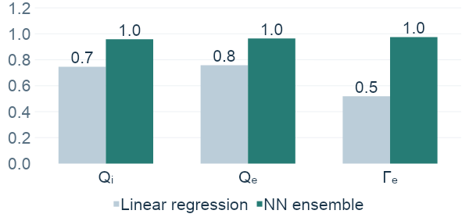
Accuracy and speed
750-case test R²
43-case check
R² 0.970–0.997
CPU latency
0.81 ms / case
Mean baseline R² ≈ 0
Notes:
Sources: /Users/ryanlindberg/Desktop/Classes/DSC180A/assignments/A2/results/test_metrics.csv, /Users/ryanlindberg/Desktop/Classes/DSC180A/assignments/A2/results/sat3/metrics.csv, /Users/ryanlindberg/Desktop/Classes/DSC180A/assignments/A2/results/inference_timing.csv, /Users/ryanlindberg/Desktop/Classes/DSC180A/assignments/A2/results/learning_curve_metrics.csv, /Users/ryanlindberg/Desktop/Classes/DSC180A/assignments/A2/results/sat3/trend_checks.csv, and /Users/ryanlindberg/Desktop/Classes/DSC180A/assignments/A2/03_evaluation.ipynb.
The GELU/ReLU model won on validation error. The 750-case test set had already been inspected in earlier work, so this refreshed comparison is exploratory rather than a new untouched assessment.
Test RMSE in gyro-Bohm units, ordered Q_i, Q_e, Gamma_e: 15.529441, 11.270592, 3.288487. It beats the mean and linear baselines for all three targets.
The 43 original SAT3 cases have R² values 0.9701799, 0.9972705, 0.9876232. They are controlled scans with narrower output ranges, not an equally broad random test. Compared with the prior GELU/tanh ensemble, ion-heat R² decreases from 0.9867 to 0.9702, electron-heat R² rises from 0.9890 to 0.9973, and particle-flux R² changes from 0.9910 to 0.9876. SAT3 did not select the activation.
Single-case latency is 814.349 microseconds, the median of seven warm DSMLP CPU repetitions with one prediction thread. It includes scaling, inverse transformations, and averaging, and excludes loading, file access, and physical feature construction. Batch throughput is 4.510 microseconds per case for a batch of 750. Retraining all five members took 24.012 seconds using four CPU threads. These are new measurements, and do not isolate the causal speed effect of changing the activation.
Learning curves use nested training sizes 250, 500, 1000, 2000, and 3496, with fixed training settings and subset-fitted scalers. Mean normalized test RMSE changes from 0.30859 at 250 cases to 0.15360 at 3496. The change from 2000 to 3496 cases is -11.1%. This is one nested sample sequence without resampling uncertainty.
The model matches 25 of 27 temperature-scan changes and 45 of 48 isotope changes. It has 2 particle-flux sign errors. Overall scores do not guarantee each local ordering or sign. Actual TGLF runtimes are unavailable, so no measured simulator speedup ratio is claimed.

Slide 4
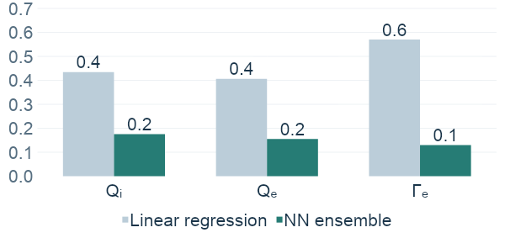
Accuracy and speed
750-case test nRMSE
43-case check
nRMSE 0.018–0.048
CPU latency
0.81 ms / case
nRMSE = RMSE / training standard deviation
Notes:
Sources: /Users/ryanlindberg/Desktop/Classes/DSC180A/assignments/A2/results/sat3/test_comparison.csv, /Users/ryanlindberg/Desktop/Classes/DSC180A/assignments/A2/results/test_metrics.csv, /Users/ryanlindberg/Desktop/Classes/DSC180A/assignments/A2/results/inference_timing.csv, /Users/ryanlindberg/Desktop/Classes/DSC180A/assignments/A2/prepared/targets_raw.csv, and /Users/ryanlindberg/Desktop/Classes/DSC180A/assignments/A2/03_evaluation.ipynb.
For each target, nRMSE = RMSE in original gyro-Bohm flux units divided by that target's population standard deviation across the 3,496 training cases. It is dimensionless and is not normalized by the target range, mean, or test-set standard deviation. Lower is better. The same training denominator applies to the random test and SAT3 cases.
Targets are ordered Q_i, Q_e, Gamma_e. Test nRMSE: linear regression 0.434746, 0.405935, 0.570059; selected five-network GELU/ReLU ensemble 0.175686, 0.155200, 0.129924. The ensemble mean across the three targets is 0.153603. The mean baseline, omitted from the chart to match the preceding slide, has test nRMSE 0.865790, 0.829037, 0.826740.
The 43-case SAT3 check has nRMSE 0.047764, 0.018376, 0.044267 for the same target order. The visible range summarizes those three values. SAT3 contains related controlled scans with narrower flux ranges and did not select the model.
CPU latency remains 0.814349 milliseconds per case, from the same median of seven warm single-case repetitions with one DSMLP CPU thread. This is the same timing measurement shown on the preceding R² slide, not a second benchmark. It includes input scaling, target inverse transformations, and ensemble averaging; it excludes loading, file access, and physical feature construction.
The model was selected by validation error. The 750-case test set was inspected in earlier work, so this comparison is exploratory rather than a new untouched assessment.

